Slide 1
Multiplayer Reach-Avoid Games
Mo Chen, Claire Tomlin
mochen72@berkeley.edu
Hybrid Systems Laboratory
Notes:
Hi, my name is Mo Chen, and I’ll be talking about my current research on multiplayer reach-avoid games and potential future research which could be a project for this course.

Slide 2




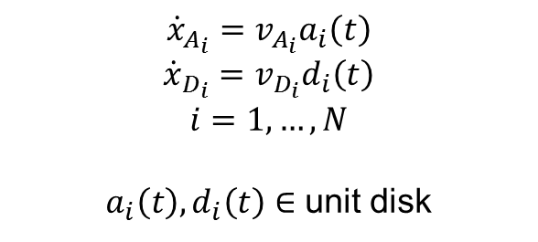


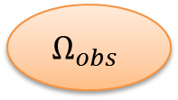

Multiplayer Reach-Avoid Game
= target
= defender
= attacker
= obstacles
$$∂Ω$$
$$Ω_{free}$$
$$D_{1},…,D_{N}$$
$$Ω_{obs}$$
$$Ω$$
$$𝒯$$
$$A_{1},…,A_{N}$$
$$Ω_{obs}$$
$${\dot{x}}_{A_{i}}=v_{A_{i}}a_{i}\left(t\right)$$
$${\dot{x}}_{D_{i}}=v_{D_{i}}d_{i}\left(t\right)$$
$$i=1,…,N$$
$a_{i}\left(t\right),d_{i}\left(t\right)∈$ unit disk
Notes:
The game is played between a team of attackers and a team of defenders on some arbitrary domain with obstacles. The attackers try to reach some target set, shown here, while avoiding capture by the defenders. An attacker is captured if she is within some radius of any defender.

Slide 3
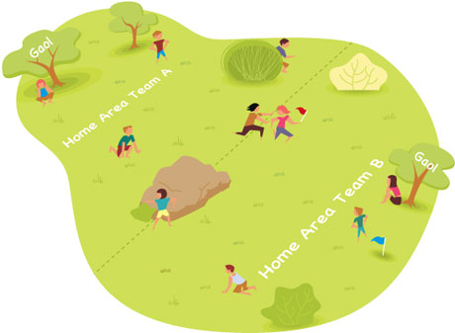
Why Multiplayer Reach-Avoid Games?
High dimensionality: Difficult to solve
Difficult to intuit
Humans sometimes play suboptimally even in a 1 vs. 1
Cooperation / Asymmetry
Applications in robotics and aircraft safety
http://playwithup.com/wp-content/uploads/2012/08/capture-the-flag-1.jpeg
Notes:
Multiplayer reach-avoid games are difficult to solve because of its high dimensionality. For example, if 10 players play on a 2D surface, their joint state space is 20 dimensions.
Despite the difficulty, it’s still important to find the optimal way to play, because even in a 1 vs 1 situation, humans intuition is suboptimal. This was demonstrated by work done previously in our lab, where two students played capture the flag against each other. One player had access to the calculated optimal control in real time, and the other player played based on intuition. The player who did not have the optimal control information lost the game even when he would have won if he played optimally.
With multiple players on each team, cooperation makes the game even more complex.
Applications of these games include safety in automated systems such as robots and aircrafts

Slide 4
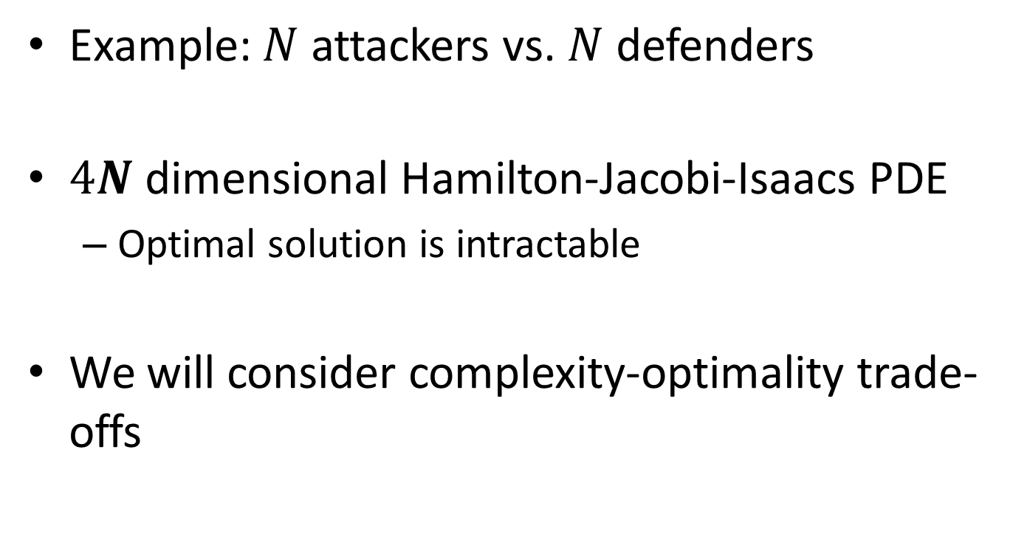
Multiplayer Reach-Avoid Game
Example: $N$ attackers vs. $N$ defenders
$4N$ dimensional Hamilton-Jacobi-Isaacs PDE
Optimal solution is intractable
We will consider complexity-optimality trade-offs
Notes:
In an N vs. N game, the optimal solution to this problem requires solving a 4N dimensional HJI PDE.
This is intractable, because the HJI PDE is solved by gridding up the state space, so the computation complexity scales exponentially with the number of dimensions. We are only able to solve the 1 vs. 1 game using an HJI PDE
Because of this, we will need to approximate the 4N dimensional solution by considering complexity-optimality trade offs.

Slide 5
From Two Player to Multiplayer
= target
= defender
= attacker
= obstacles
Use the two player game as a building block:
- Construct a graph based on attacker-defender pairs
Notes:
Recently, I have made one such trade off by using the solution to the 1 vs. 1 game as a building block for an approximate solution to the full multiplayer game. This can be done by constructing a graph such that if some defender wins against some attacker, we draw an edge between them. (point to slide)

Slide 6
Maximum Matching
= target
= defender
= attacker
= obstacles
Notes:
After constructing the graph, we can find the maximum matching of the graph, which shows the optimal way for the defending team to assign an attacker to each defender. In this example, the maximum matching is of size 4, meaning that if each defender is assigned these particular attackers, then they can together prevent any attacker from reaching the target.

Slide 7
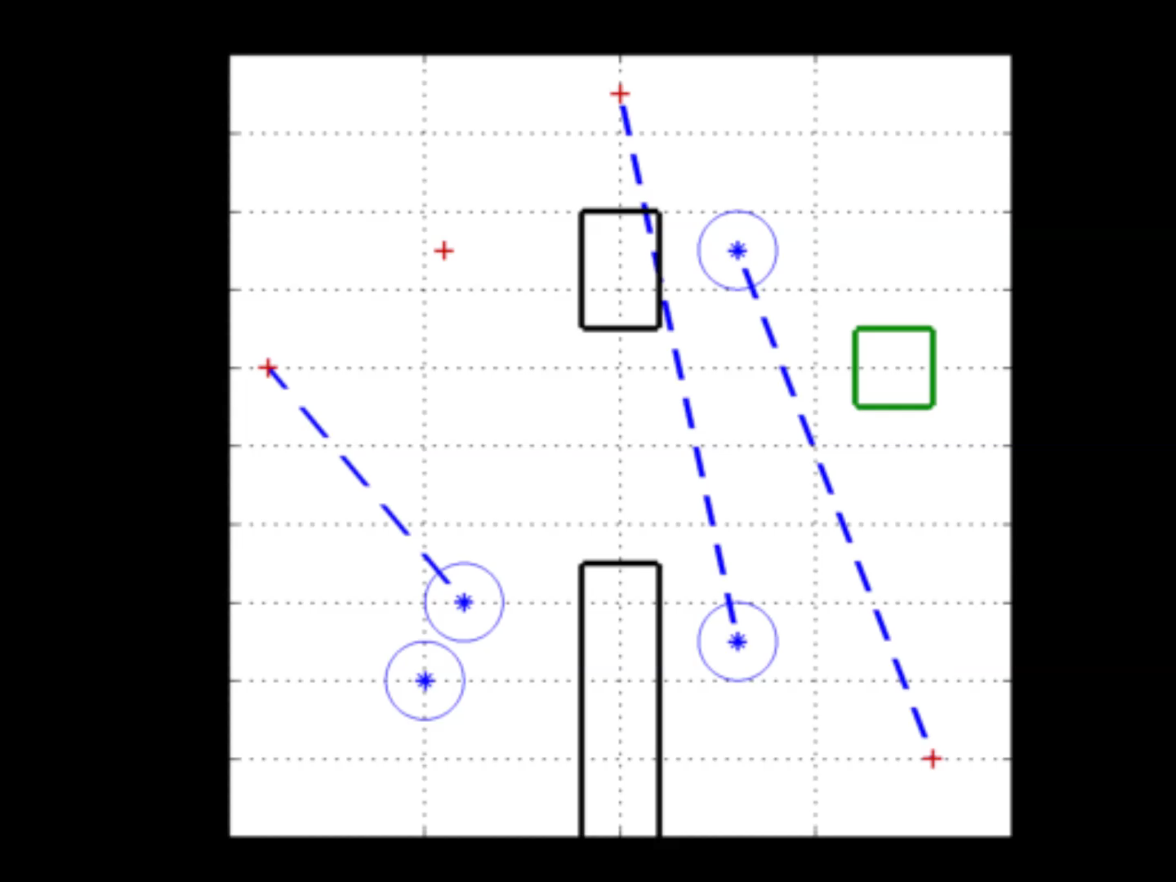
Maximum Matching
Notes:
The maximum matching can be computed in real time as the players play out the game. Often, the size of the maximum matching will increase as the players play out the game, as shown in this simulation.
The blue stars are defenders, the red crosses are attackers, the black rectangles are obstacles and the green square is the target set.

Slide 8
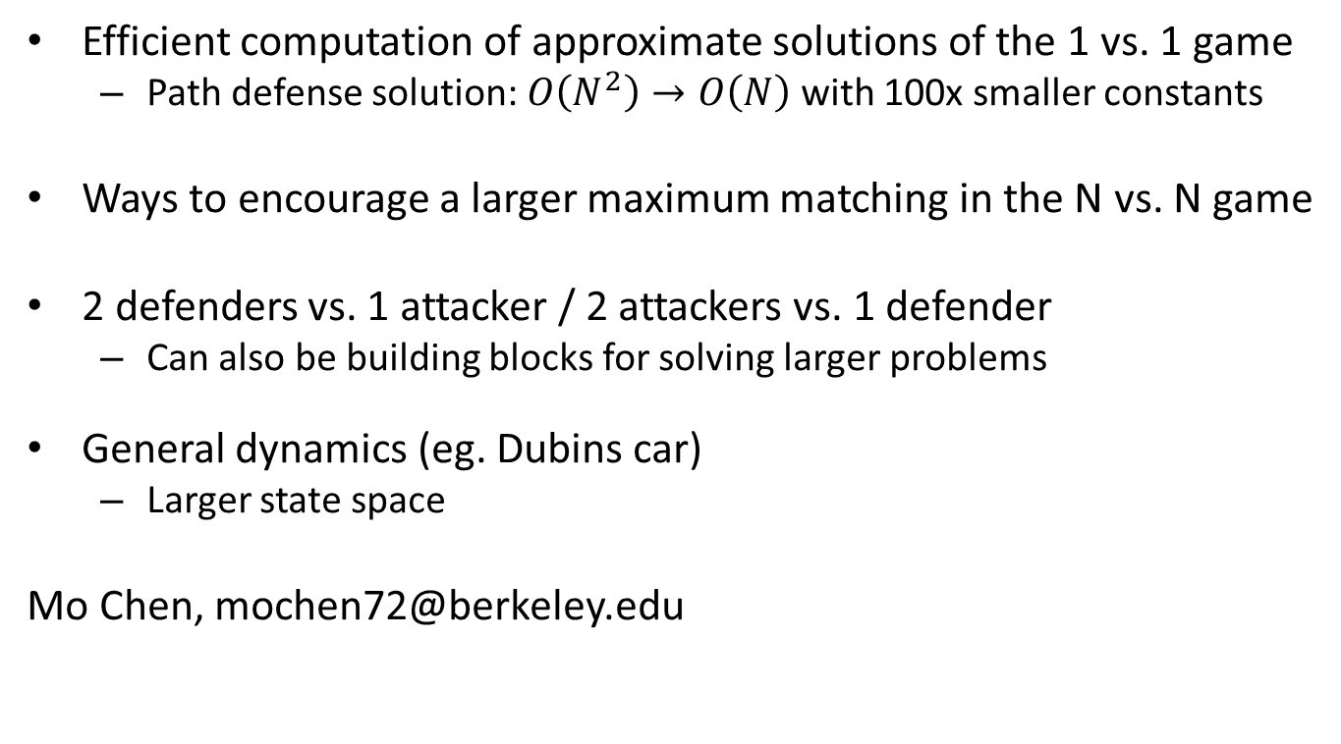



Ongoing Research
Efficient computation of approximate solutions of the 1 vs. 1 game
Path defense solution: $O\left(N^{2}\right)→O\left(N\right)$ with 100x smaller constants
Ways to encourage a larger maximum matching in the N vs. N game
2 defenders vs. 1 attacker / 2 attackers vs. 1 defender
Can also be building blocks for solving larger problems
General dynamics (eg. Dubins car)
Larger state space
Mo Chen, mochen72@berkeley.edu
$$A$$
$$D_{1}$$
$$D_{2}$$
Notes:
That was just one example of approximating the solution to a very high dimensional game by trading optimality and complexity. Here are several potential projects.

